Slide 1



Huron River: Go with the Flow!
Lara Khadr Ziwei Zhu
Ashwin Rajadesingan Erin Bagazinski

Slide 2
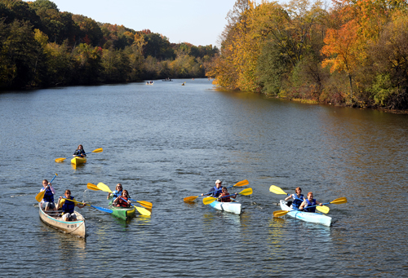
What Challenges does the HRWC face?
Restore and protect river
Science-based collaborative
Huron River Watershed Council
Dams! Dams everywhere!
Each dam is managed by a different individual, not a collaborative effort.
Need to ensure flow along the river within a certain range.
Unsure how much of change in flow is because of climate change.
Why the river flow is important:
Changes in flow means changes to Ecosystem
Impacts our ability to enjoy outdoor activities!
Notes:
Who is our client?
HRWC seeks to restore and protect the river to ensure healthy communities.
Established in 1965, HRWC is southeast Michigan’s oldest environmental organization dedicated to river protection.
Huron river water-shed works to gather science-based information about the river in order work collaboratively with citizens and the local government to promote river health.

Slide 3
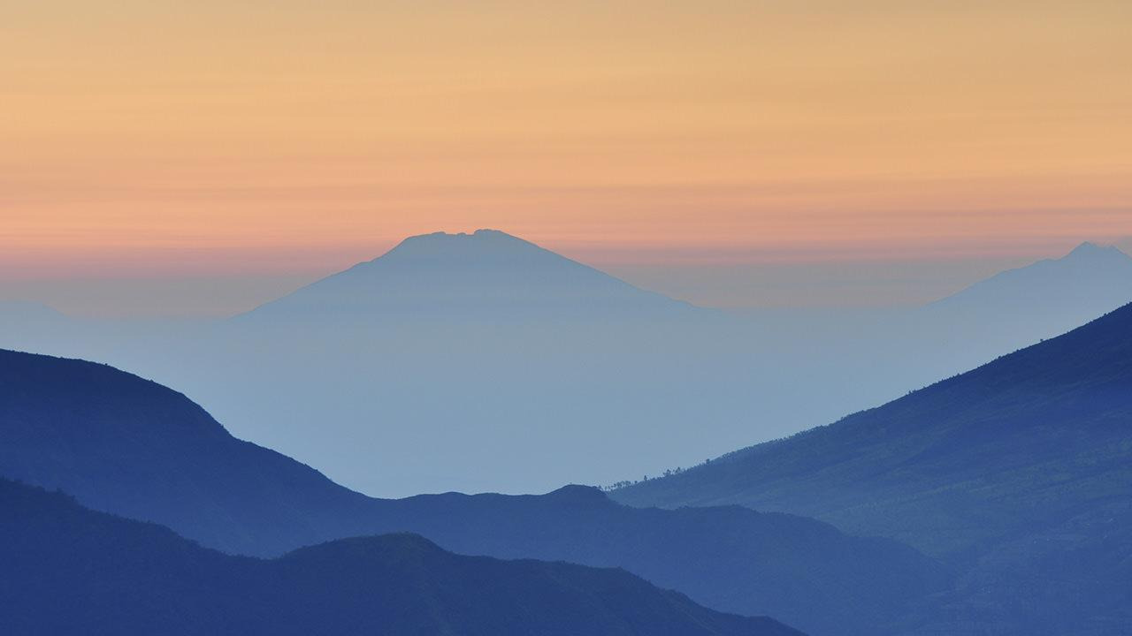
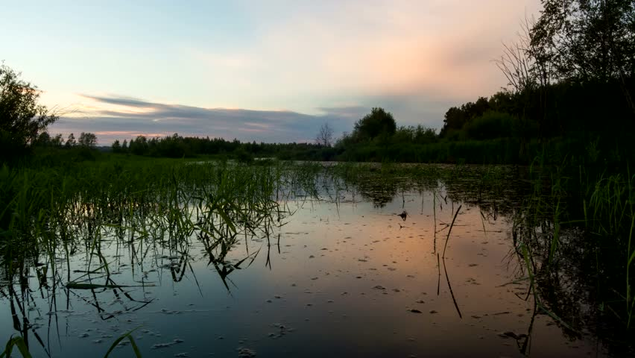
Why should you care?
Climate change
44% increase in precipitation
4 billion $$ in economic impact
Notes:
Climate change: Happens in your backyard! Water flow is influenced by climate change. There has been a 44% increase in precipitation in the last 50 years.
-River has 4 billion dollars impact on local economy.
-Due to jobs and property values, the river has an local economic impact of 4 billion $
(* emphazises the value of the river to the city of ann arbor)
-44% increase in precipitation in the last 50 years.

Slide 4

What are HRWC’s Challenges?
Dams! Dams everywhere! Each dam is individually managed.
Ensure river flow stays within a certain range.
Why the river flow is important:
Changes in flow means changes to ecosystem
Impacts our ability to enjoy outdoor activities!
Is change in flow related to climate change?
Notes:
-Each dam is managed by a different individual, not a collaborative effort. Therefore, they don’t talk to each other.
-IF flow goes too fast or too slow, it prevents the river from being healthy which affects the ecosystem and fish population. Also a flow which is too fast will cause erosion.
-Here is your opportunity to analyze impacts of climate change up close!

Slide 5

How Can We Help?
Things we can do with the data

Slide 6
The Main Questions
Sudden fluctuations?
Man-made or natural causes?
Notes:
Detect, categorize
12h window, maximum, outlier
Human impact: sudden change - detect that?
When have sudden fluctuations in water discharge levels of the Huron River occurred?
Can these fluctuations be attributed to man-made or natural causes?
Other possible questions: how that changed during the years? Any relations with precipitation (natural cause?)

Slide 7
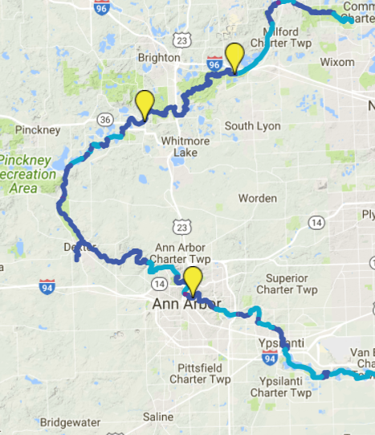
OUR DATA
1 key feature
3 locations, 30+ years
accessible to all skill levels
Notes:
Thouthands of lines, but “use friendly”, accessible to all skill levels
Intro level: summarize the data and plot in Excel
Advance: build a time series model and see how flow change over time
1 key feature: discharge volume
3 locations, 30+ yrs data, typically 15min to 1hr intervals (may have gaps, don’t need to mention that)
Accessible to all skill levels (basic level: summarization, visualization, intermediate: looking for outliers and sudden change, advance:build time series models)

Slide 8
THANKS!
Any questions?
Notes:
Bigger bolder font
Assume bad behavior audience
Audience proof
Lines are distracting
Bigger font - more slides thats cool
History, intro, motivation - good!
Example - a speific problem with river flow - - people running a dam what happens - - bank erodes, fish population habitiat?
Really paint it out simplistically
Specific example
Data format?
Mention the data format so people know
More data examples?
Mybe beyond the pitch stage, could help your different groups
Pitch to different skill levels good!
Complexity is there but also basic things there too
Helpful for less experience
Offer a re-formatted file? 1 or more versions of the data that are flattened a bit - figure out if rise is due to dam activity or rainfall? Doesn’t need time as much?
Someone who doesn’t know time series could still do it
1 line per day - time aggreagation
2nd version of file to clean up the time messiness
Can we work backward from the data to figure out percentages of what it was at a time,
Calculate baseline ---- pick a baseline so numbers
Can get longer if we want 4 ½ minutes good + limited questions
Natural vs human cause - examples or what that might mean or implications of this
Names of variables
Specific questions to answer - with flashing lights!
Want to know if thing is result of dams or rainfall we dont have control over, but how dams might have impacted or helped what happened
People need help with given research questions
* rain gauge data to supplement
Dam management changes over time
Easy questions vs more difficult in depth questions.
MAP OF ANN ARBOR WHERE GAUGES ARE ********

